Slide 1


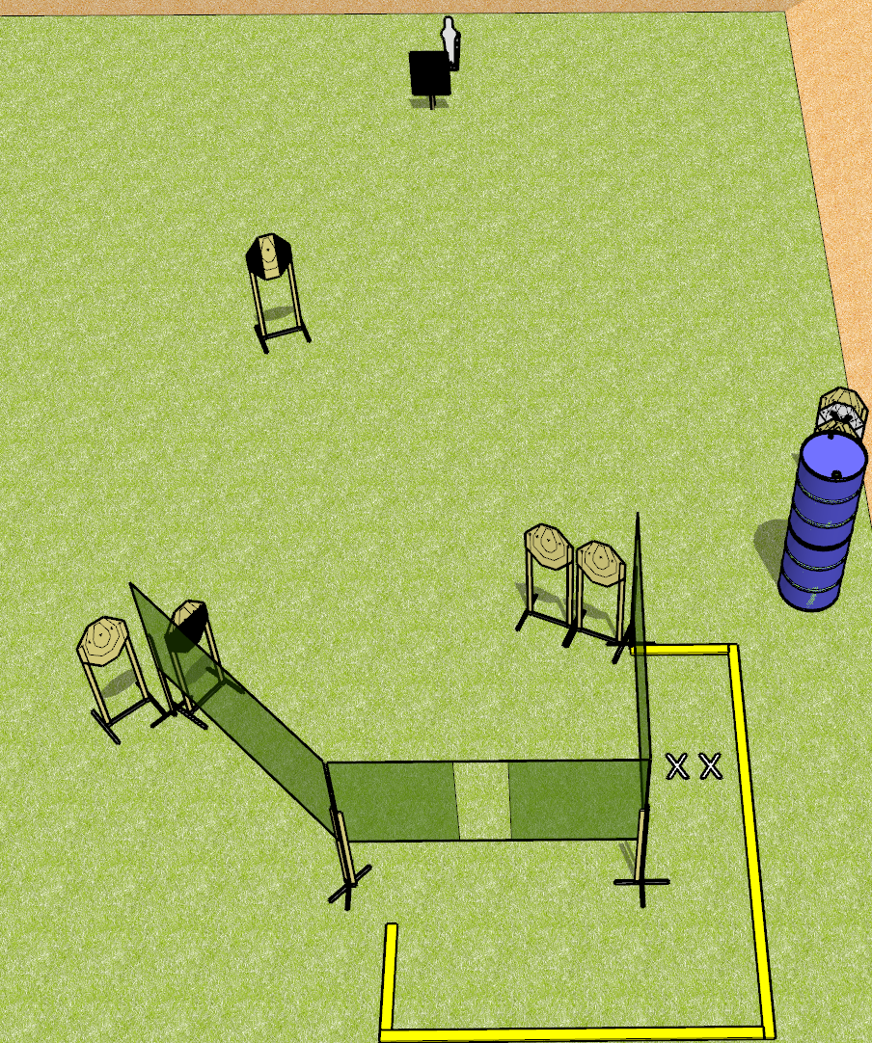
 | Dothan Gun Club – USPSA Match Move Around Course Designer : Drew Coleman
Round Count 15 rounds 7 IPSC targets 1 Mini popper
Equipment List 5 wall feet 2 3 foot fault lines 1 18x24 plate and stand 1 2/3 hard cover, 1 tuxedo Notes: Use plate to cover half of popper from the port. Far right target near barrels is stacked with NS

Slide 2
Move Around
Written Stage Briefing
Move Around is a 15 round, 75 point, Comstock course of fire. There are 7 IPSC targets and 1 mini poppers. The best 2 hits on paper will score, and steel must fall to score. The start signal is audible.
Handgun start position is both feet on X’s, wrists below belt. Handguns is loaded and holstered.
PCC start position is both feet on X’s. Loaded carbine is held with both hands, stock on belt, safety on.
On start signal, engage targets as they become available from within the shooting area.

Slide 3
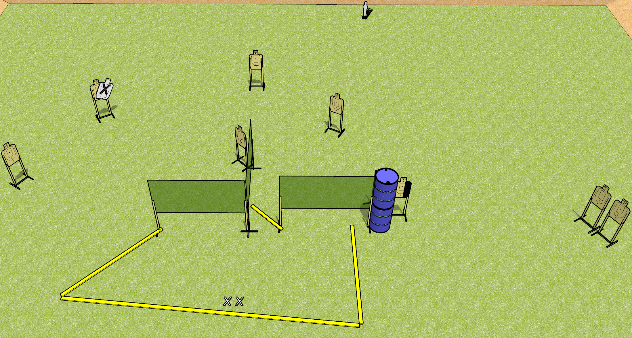
 | Dothan Gun Club – USPSA Match Thrown Down Course Designer : Drew Coleman
19 rounds 9 USPSA targets 1 mini popper
Equipment List 5 wall feet 1 medium or short fault line 1 right side hard cover Note: Make sure they have to lean out to get the open target behind the barrel
Open target behind barrel

Slide 4
Thrown Down
Written Stage Briefing
Thrown Down is a 19 round, 95 point, Comstock medium course. There are 9 USPSA targets and 1 mini popper. The best 2 hits on paper will score, and steel must fall to score. The start signal is audible.
Handgun start position is both feet on X’s, wrists below belt. Handgun is unloaded and holstered.
PCC start position is both feet on X’s. Unloaded carbine is held with both hands, stock on belt, safety on.
On start signal, engage targets as they become available from within the shooting area.

Slide 5
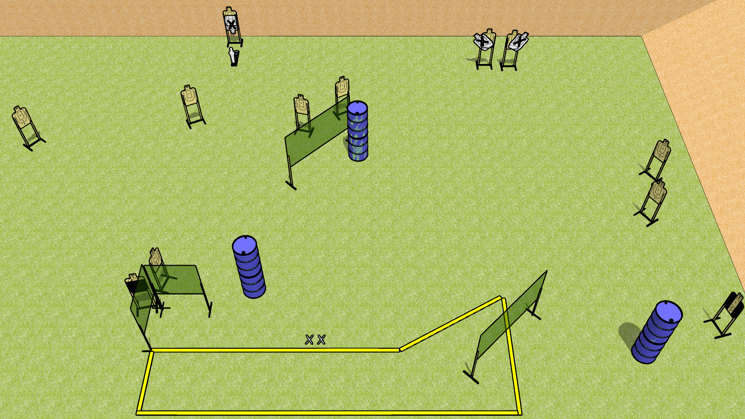
 | Dothan Gun Club – USPSA Match Danger Danger Course Designer : Drew Coleman
Round Count 25 rounds 12 USPSA targets 1 mini popper
Equipment List 7 wall feet 1 medium fault line 1 Tuxedo, one action target Notes: tuxedo on the right – position the barrels to force shooters up along the wall slightly

Slide 6
Danger Danger
Written Stage Briefing
Danger Danger is a 25 round, 125 point, Comstock course of fire. There are 12 USPSA targets and 1 mini popper. The best 2 hits on paper will score, and steel must fall to score. The start signal is audible.
Handgun start position is both feet on X’s, heels against fault line, wrists below belt. Handgun is loaded and holstered.
PCC start position is both feet on X’s, heels against fault line. Loaded carbine is held with both hands, stock on belt, safety on.
On start signal, engage targets as they become available from within the shooting area.

Slide 7
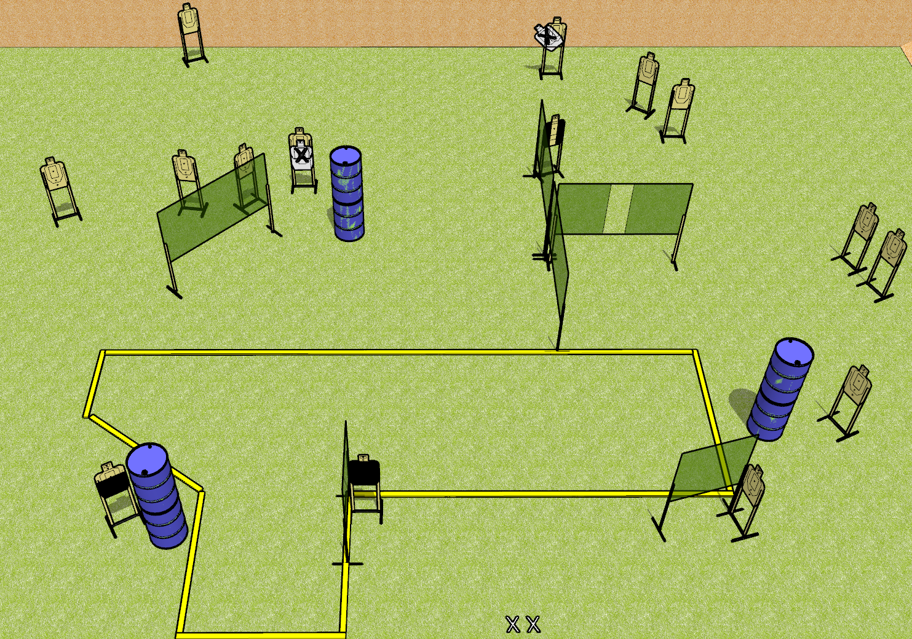
 | Dothan Gun Club – USPSA Match Raygun Course Designer : Drew Coleman
Round Count 30 rounds 15 USPSA targets
Equipment List 11 wall feet 1 action target, 1 headshot, 1 Tuxedo Notes: Make sure the stage is wide enough for the headshot to not shoot through to the targets in the back right, 20ft min. Barrel in the center is to block shoot through. Upper right – the open target that’s angled inwards should be available from the far left corner of the stage. Consider moving X’s some place more annoying.

Slide 8
Raygun
Written Stage Briefing
Raygun is a 30 round, 150 point, Comstock field course. There are 15 USPSA targets. The best 2 hits on paper will score, and steel must fall to score. The start signal is audible.
Handgun start position is both feet on X’s, wrists below belt. Handgun is loaded and holstered.
PCC start position is both feet on X’s. Loaded carbine is held with both hands, safety on.
On start signal, engage targets as they become available from within the shooting area.

Slide 9
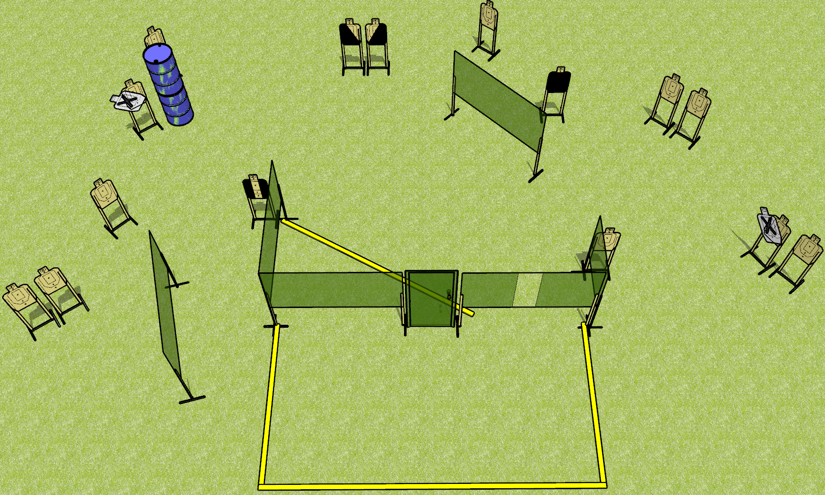
 | Dothan Gun Club – USPSA Match Open Up Course Designer : Drew Coleman
Round Count 30 rounds 15 USPSA targets
Equipment List 10 wall feet 1 tuxedo, 1 headshot, 1 left and 1 right diagonal Notes: Use 10 foot fault lines to extend back. Left NS target needs to be visible from the forward shooting area. Headshot target should only be visible from the window.

Slide 10
Open Up
Written Stage Briefing
Open Up is a 30 round, 150 point, Comstock field course. There are 15 USPSA targets. The best 2 hits on paper will score. The start signal is audible.
Handgun start position is both hands touching door. Handgun is loaded and holstered.
PCC start position is muzzle touching door. Loaded carbine is held with both hands, safety on.
On start signal, engage targets as they become available from within the shooting area.

